Slide 1
Sentimental Analysis using Binary Classification in deep learning
Sharad Kumar Singh

Slide 2
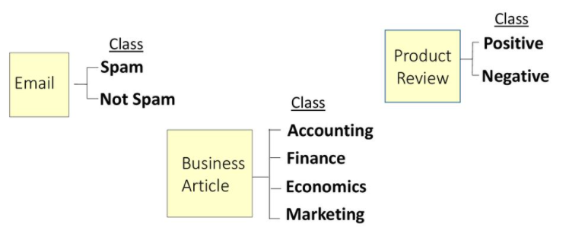
What is Binary Classification
Binary classification is also know as text classification, Sentimental Analysis.
Text classification is the process of assigning a labelled category, ,known as class, to text
Few examples:

Slide 3
Why use Deep learning?
We have more text that ever before.
For large data set machine learning models are very efficient.
Programming a rule based system for text classification (using a series of IF THEN ELSE statements) will require tons of rules.
Also rule based model can only be written if we know all the situations under which decisions needs to be made.
For sentimental analysis we do not have binary data directly.

Slide 4
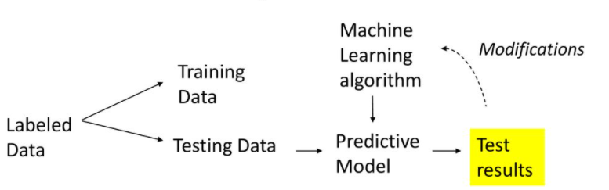

Workflow
We begin by dividing labelled data into a set of training data and a set of test data.
Using the training data the algorithm creates a predictive model. In our case, the text classifier.
Test data is used to validate the predictive model.
Based on the test results, we may either make modifications to algorithm or we may want to train more data.
When we are satisfied with the results, we use the predictive model to classify the new , unclassified data.

Slide 5
Implementation
Library: Keras
Dataset: IMDB dataset – It is a set of 50,000 highly polarized reviews from the Internet Movie Database.
Training data and Test data: 50000 reviews are split into 25,000 reviews for training and 25,000 reviews for testing
Dictionary size: Top 10,000 most frequently occurring words in the training data are used for the model. Rare words will be discarded. This allows you to work with vector data of manageable size.
Train labels and Test labels: lists of 0s and 1s, where 0 stands for negative and 1 stands for positive

Slide 6
Preparing the data
The reviews (sequences of words) have been turned into sequences of integers, where each integer stands for a specific word in a dictionary.
Turning integers into Tensors:
Padding the lists so that they all have the same length
Turn them into an integer tensor of shape (samples, word_indices)
Using the first layer (embedding layer) which is capable of handling such integer tensors (the Embedding layer).
Using a Dense layer, capable of handling floating-point vector data.

Slide 7
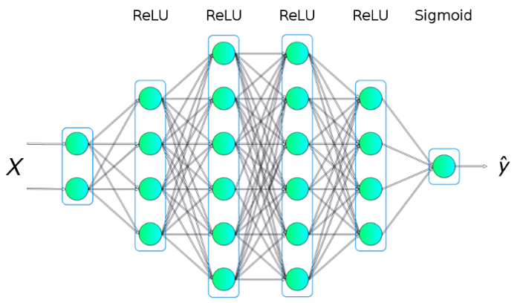
The Neural Network
Model: Sequential -it is built from a number of layers stacked together
I/p data – vectors
o/p data – scalars (1/0)
Embedding layer
Dense layers :
16 neurons
Activation function - Relu
Output layer
1 neuron
Activation function - Sigmoid

Slide 8

High level network

Slide 9
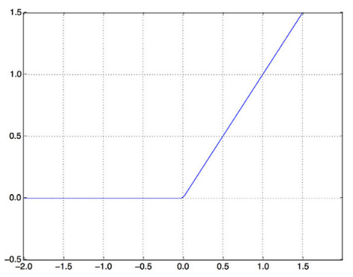
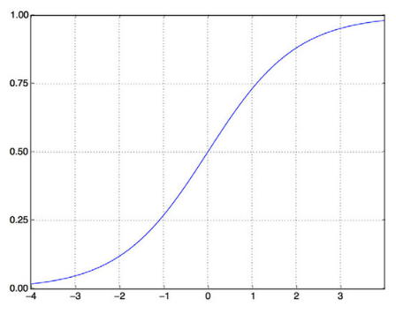
Activation Functions
A relu (rectified linear unit) is a function meant to zero out negative values.
A sigmoid “squashes” arbitrary values into the [0, 1] interval, outputting something that can be interpreted as a probability.
Fig: Relu
Fig: Sigmoid

Slide 10
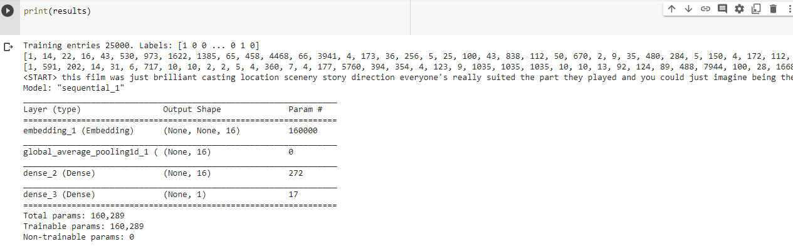
Model summary

Slide 11
Compiling and Fitting the model
Compiling
Loss - The goal of the neural network is to minimize the loss function, i.e., the difference between predicted and observed values. There are many functions we can use. We pick binary_crossentropy because our label data is Positive (1) and (0) Negative.
Optimizer - An algorithm designed to minimize the loss function in the quickest way possible - "adam“ is used in this test.
Metrics- what metrics to display as it runs. Accuracy means how accurately the evolving model predicts the outcome – acc used in this test.
Fitting
Epoch = Number of iterations we decide to take, meaning the amount of times we pass through the neural network = 40 in this test.
Batch size= number of training examples utilized in one iteration = 512 in this test

Slide 12
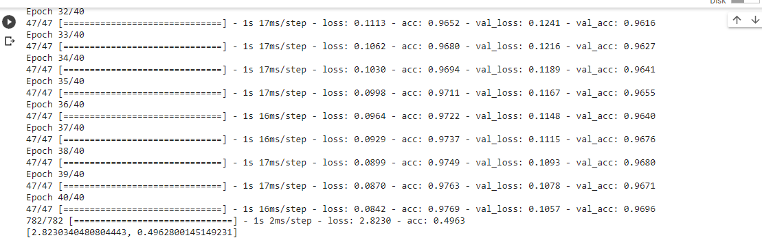
Result
Result show diminishing loss and increasing accuracy with each epoch.
However evaluation showed only 49% accuracy.
Further model tuning is required to achieve better accuracy.

Slide 13
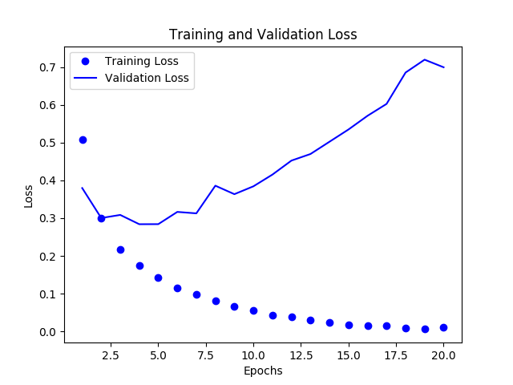
Plotting Training and validation loss

Slide 14
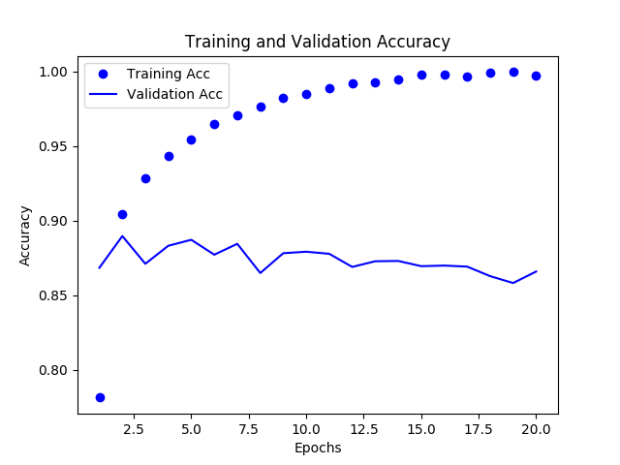
Training and validation accuracy

Slide 15
Complete Source code
Double click to activate

